Slide 1

Nokia: Why Did It Fail?
Industry Analysis & Lessons Learned
Presented by: [Team Name]

Slide 2
Agenda
📊 Company Background & History
📈 Peak Performance & Market Leadership
📉 The Beginning of Decline
🌐 Market Trends & Industry Disruption
⚔️ Competitive Analysis
💻 Software & Strategy Failures
🎯 SWOT Analysis
💰 Financial Collapse
📱 Product Gallery
🎓 Legacy & Lessons Learned
🔮 Future Outlook
❓ Q&A

Slide 3
Company Background & History
1865
1960s
1980s
1990s
2000s
Founded as paper mill
Entered electronics
Focus on telecom
Mobile phone leader
Smartphone era begins
Key Facts:
• Founded in Finland by Fredrik Idestam
• Transitioned from paper → rubber → electronics → telecom
• Became world's largest mobile phone vendor (1998-2012)
• At peak: 40% global market share in mobile phones

Slide 4
Peak Performance & The Beginning of Decline
📈 PEAK (1998-2007)
📉 DECLINE (2007-2014)
• World's largest mobile phone vendor
• 40% global market share at peak
• Dominated feature phone era
• Strong in emerging markets
• Revenue: €51.1B (2007)
• 132,000 employees worldwide
• Symbian OS market leader
• iPhone launch (2007) disrupted market
• Android adoption accelerated
• Symbian became obsolete
• Windows Phone partnership failed
• Market share dropped to 3%
• Mobile division sold to Microsoft
• 25,000+ job cuts

Slide 5
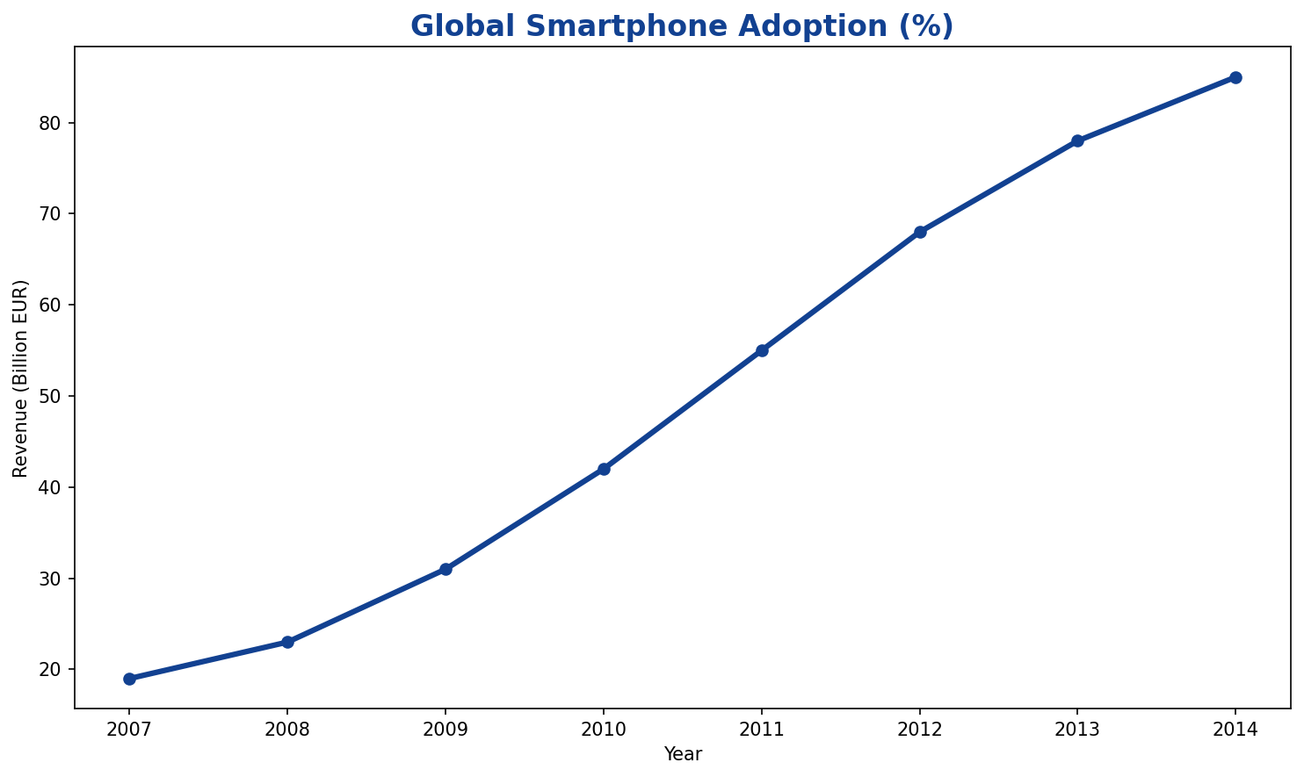
Market Trends & Industry Disruption
Key Industry Disruptions:
🔄 Feature phones → Smartphones
📱 Hardware focus → Software ecosystems
🏪 Carrier control → App stores
🌐 Closed systems → Open platforms
💡 Innovation cycles accelerated
🎯 User experience became critical

Slide 6
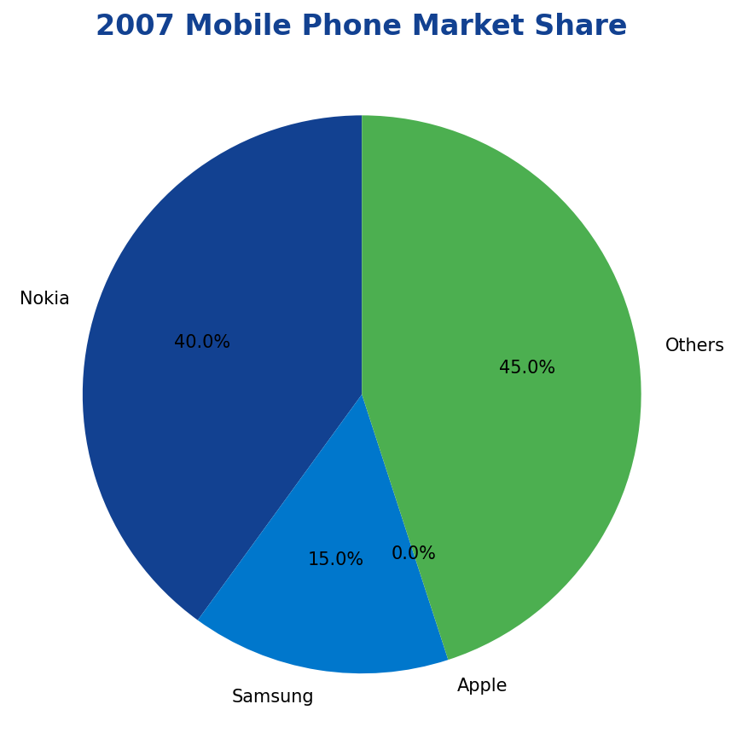
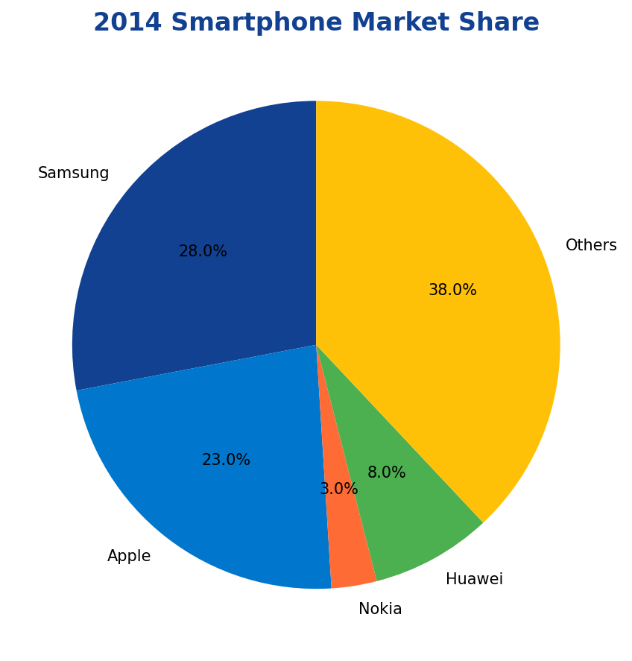
Competitive Analysis: Market Share Evolution
Apple
LOGO
Samsung
LOGO
Huawei
LOGO
Ericsson
LOGO

Slide 7
Software & Strategy Failures
Symbian OS
App Ecosystem
User Experience
Outdated architecture
Limited developer support
Complex interface
Innovation Speed
Strategic Partnerships
Market Response
Slow release cycles
Microsoft dependency
Too little, too late

Slide 8
SWOT Analysis
STRENGTHS
WEAKNESSES
• Strong brand recognition
• Global distribution network
• Hardware expertise
• Patent portfolio
• Emerging market presence
• Outdated software platform
• Slow innovation cycles
• Poor user experience
• Limited app ecosystem
• Rigid corporate culture
OPPORTUNITIES
THREATS
• 5G infrastructure market
• IoT and connected devices
• Enterprise solutions
• Network equipment
• Cloud services
• Smartphone market dominance
• Platform ecosystems (iOS/Android)
• Chinese competitors
• Rapid technology changes
• Consumer preference shifts

Slide 9
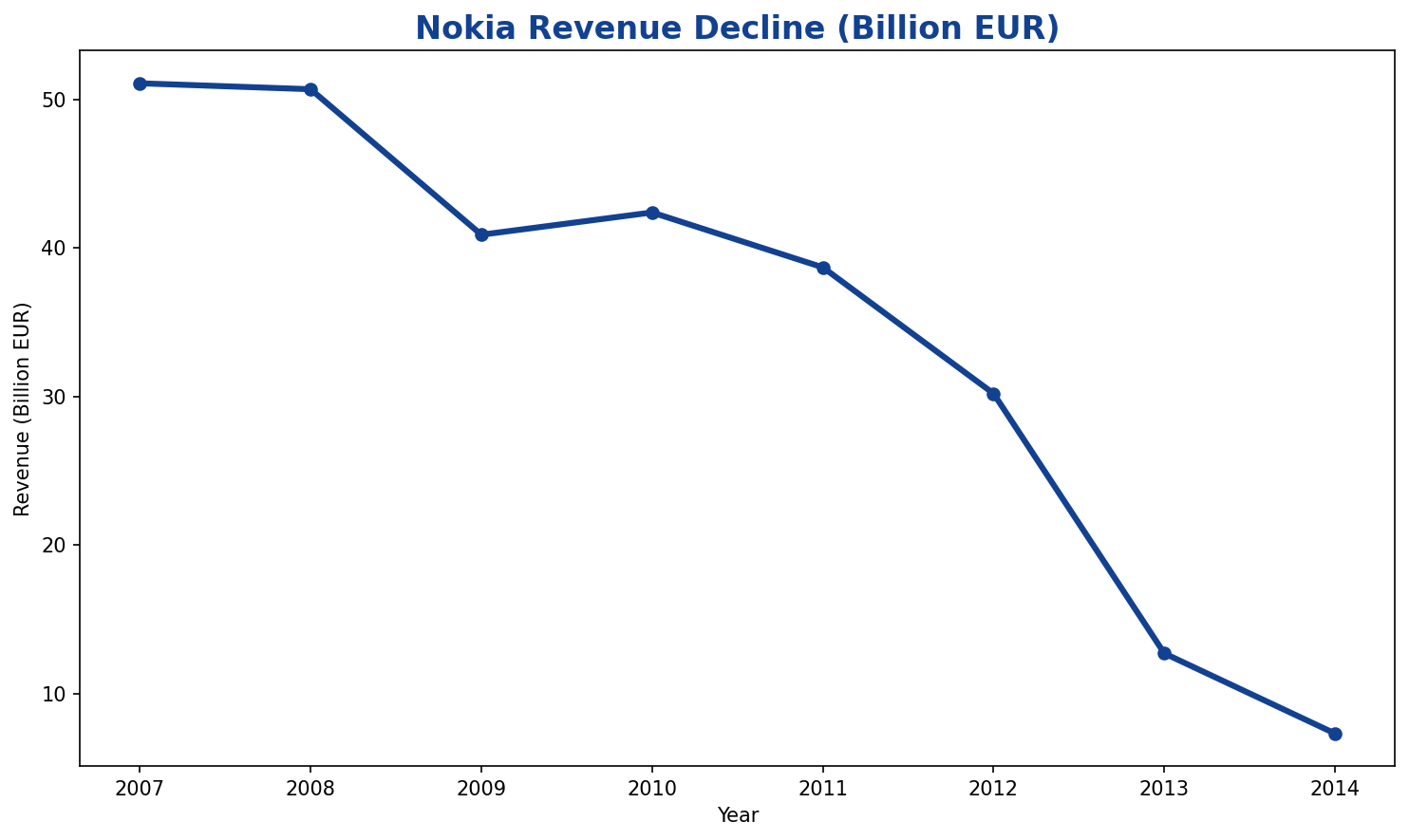
Financial Collapse: Revenue & Profit Decline
Key Financial Metrics:
📉 Revenue Peak (2007): €51.1B
📉 Revenue Low (2014): €7.3B
📉 Decline: -86% over 7 years
💰 Mobile Division Sale: €5.4B
💼 Job Cuts: 25,000+ employees
📊 Market Cap Loss: ~€100B
🏭 Restructuring Costs: €2.1B
📱 R&D Investment Wasted: €15B+

Slide 10
Product Gallery: From Glory to Decline
Nokia 3310
Nokia N95
Nokia Lumia 920
Nokia Networks
[IMAGE]
[IMAGE]
[IMAGE]
[IMAGE]
Iconic Feature Phone
Smartphone Pioneer
Windows Phone Era
5G Infrastructure
Symbian OS
HERE Maps
Nokia Bell Labs
[IMAGE]
[IMAGE]
[IMAGE]
Mobile Operating System
Navigation Platform
Research & Innovation

Slide 11
Legacy, Impact & Lessons Learned
🔄 Adapt or Perish
💻 Software is King
Technology disruption requires rapid adaptation. Nokia's slow response to smartphones cost them the market.
Hardware excellence isn't enough. Software platforms and ecosystems determine market success.
👥 User Experience Matters
🚀 Innovation Speed
Complex interfaces and poor UX drive customers away. Simplicity and intuitive design are crucial.
Fast iteration and quick market response are essential in tech. Bureaucracy kills innovation.

Slide 12
Future Outlook: Nokia's Reinvention
🌐 Network Infrastructure Leader
📡 5G technology and equipment
☁️ Cloud and edge computing solutions
🔬 Bell Labs research and innovation
🏭 Industrial IoT and automation
🛡️ Cybersecurity and network security
🎯 Focus on B2B enterprise solutions
💡 Patent licensing and IP monetization
🤝 Strategic partnerships and acquisitions

Slide 13
Thank You!
Questions & Discussion
📧 contact@team.com
🌐 github.com/team/nokia-analysis
📱 @team_handle

